Slide 1
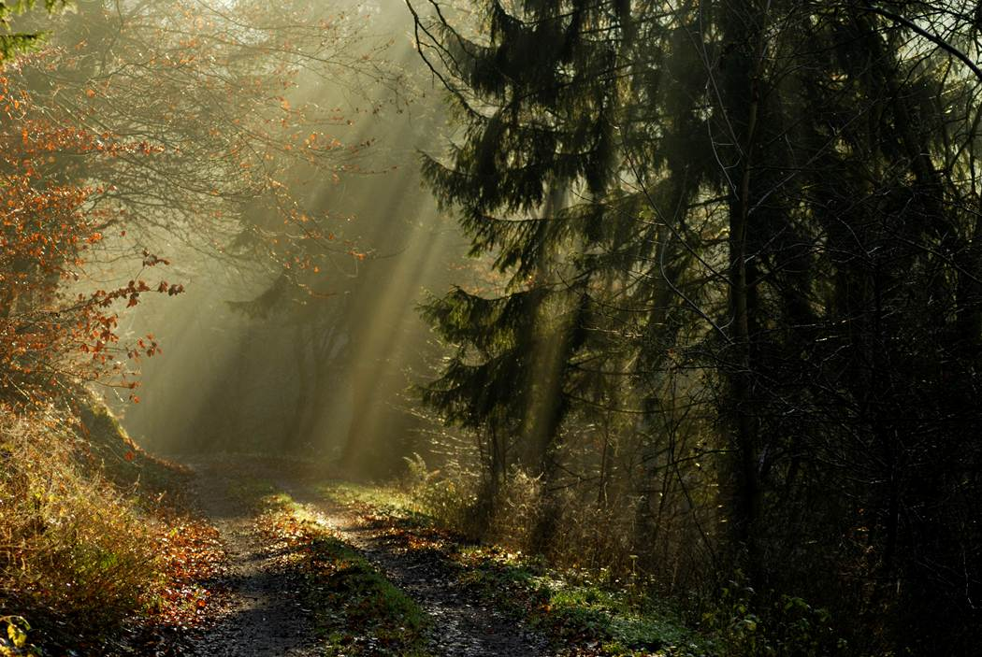

Welcome to The Trek!
The Trek is an educational program that assists youth and adults, individuals or families, to build on the positive areas in their lives and to work on identifying and strengthening places that need help. This program (under a different name) was used for over a decade in Michigan, working with groups ranging from At-Risk / Adjudicated Youth to teenagers and college students.
In 2011, we began the work of revising and updating The Trek to allow us to serve a wider audience. We are seeking to help people from all backgrounds as they discover their gifts, rebuild and restore relationships and gain insight into who they are and who they can choose to be. This program is designed to be interactive, hands-on and life-changing.
When the revisions are completed, we will be offering The Trek through an online format and through Retreat Weekends / Weeks held at our partner facilities throughout the country. Our target for launch of the online classes is March 1, 2012.
We would like to thank Crescent Lake Bible Camp for their generous support as we get our new programs up and running. Please be sure to check out their website to see all of the new programs we are offering as part of our partnership with this great organization!
- Barry and Maria Rudesill
The Trek
What Is The Trek?
Home
Programs
History
Get Started…
Contact Us

